Slide 1

*****
Hotel Management System
*****
Presenter: Phan Thanh Tùng - Fresher .NET
VMO Holdings

Slide 2

Table of contents
01
02
Overview
Technologies
03
04
Main features
Project structure
Briefly introduce project and describe objectives
Describe what technologies are used
Describe main features of product
Mockup and diagrams
VMO Holdings

Slide 3


Overview
- Introduction: This project is aim at providing an easy-to-use and simple way to manage hotel for any hotel managers.
- Objectives:
+ Allow managers and staffs to manage information about their customers, employees and rooms in their hotel system.
+ Provide statistical tables to highlight important data from customers, employees and rooms.
VMO Holdings

Slide 4


Overview
- Objectives (cont):
+ Allow managers and staffs to book room for their customers easily and check-in, check-out with visualized data-related tables and easy-to-use forms.
+ Allow managers and staffs to search for customers and employees based on their name or number.
+ Allow managers and staffs to search for rooms' information based on room types or room status.
VMO Holdings

Slide 5


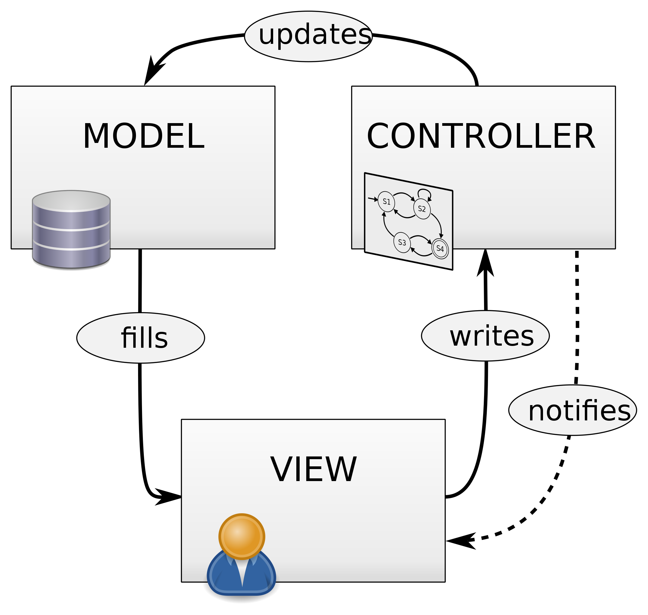

Technologies
- Programming language: C# .NET
- Front-end: MVC model
- Back-end: ASP.NET Core project (.NET 5)
+ Database: SQL Server
Stored Procedures
API Endpoints
MVC Controllers
MVC Views
VMO Holdings

Slide 6




Main features
Manage basis data
Manage room
Manage payment
Manage user account
Manage employee
- Admin/Manager role
VMO Holdings
Notes:
Briefly describe

Slide 7
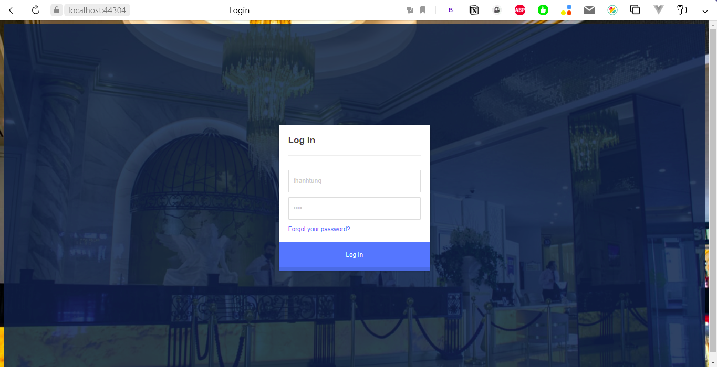






Login
Logout
Change information
Manage customer
Book room
Check in room
Check out room
Make statistical reports
Main features
- Staff role
VMO Holdings

Slide 8
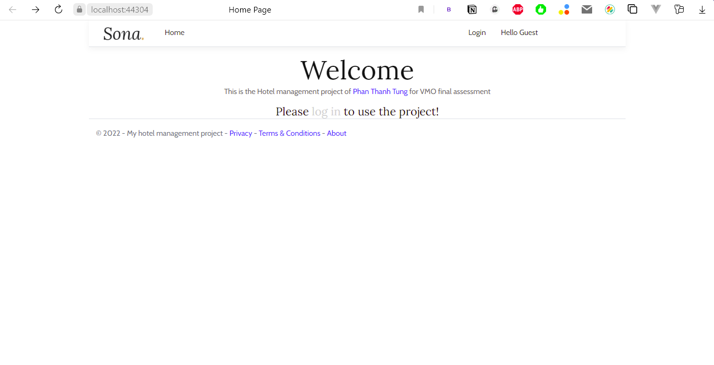
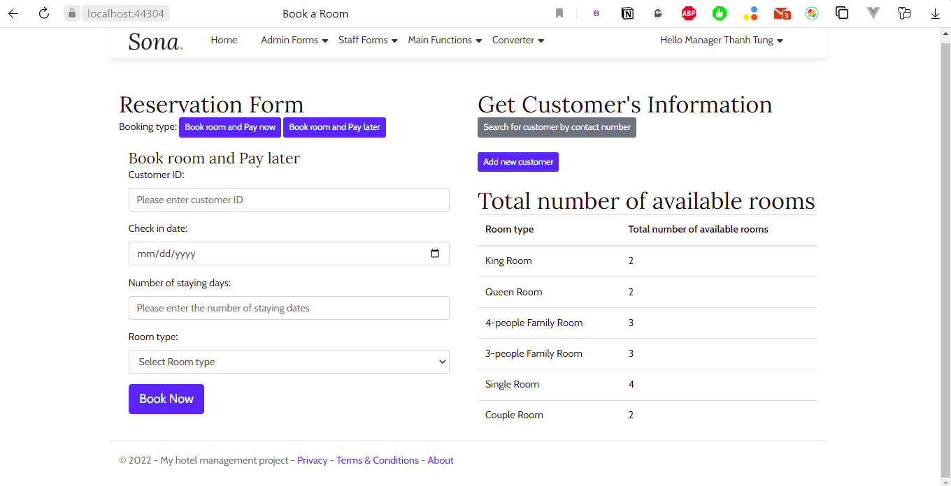
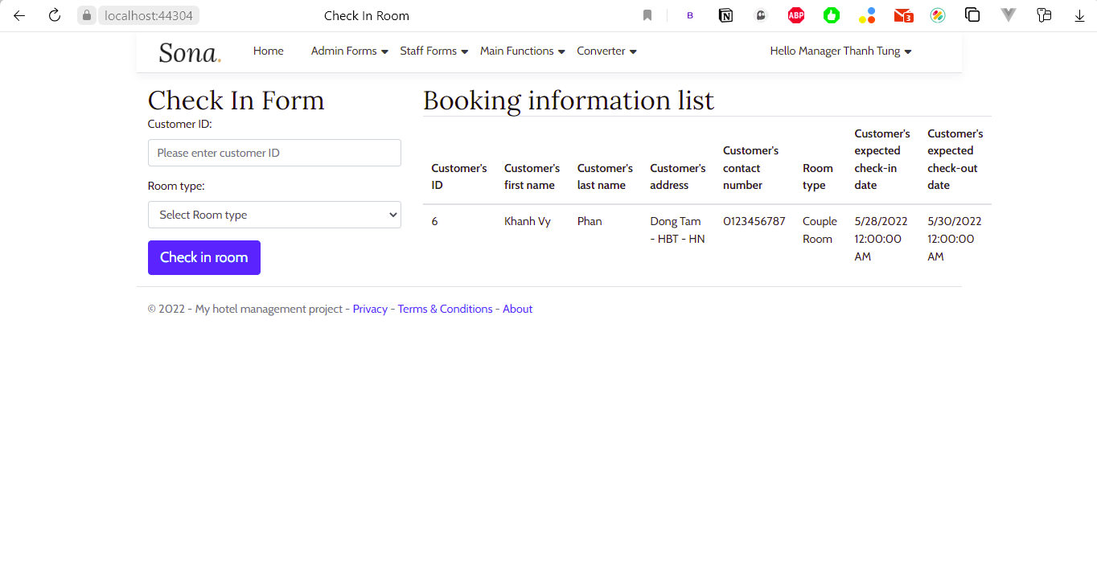
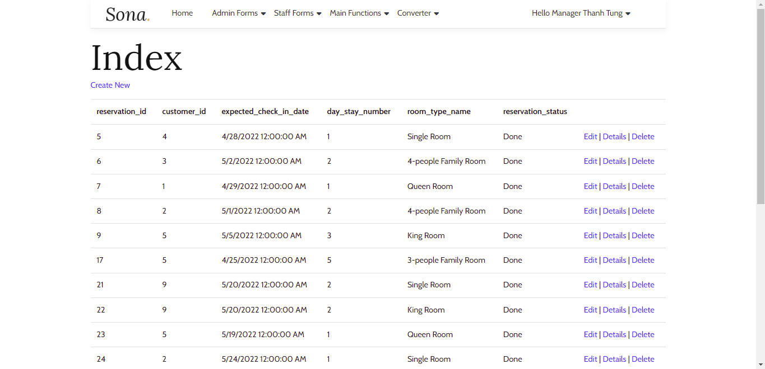
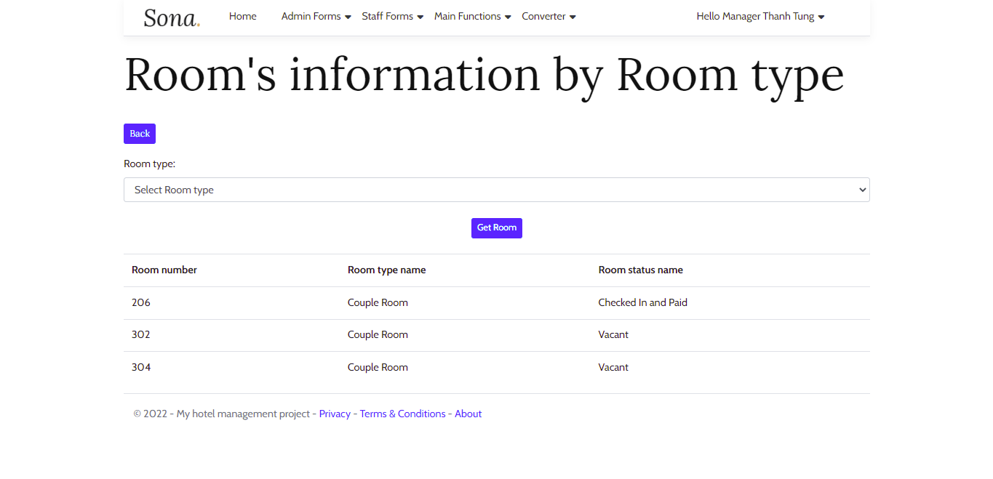
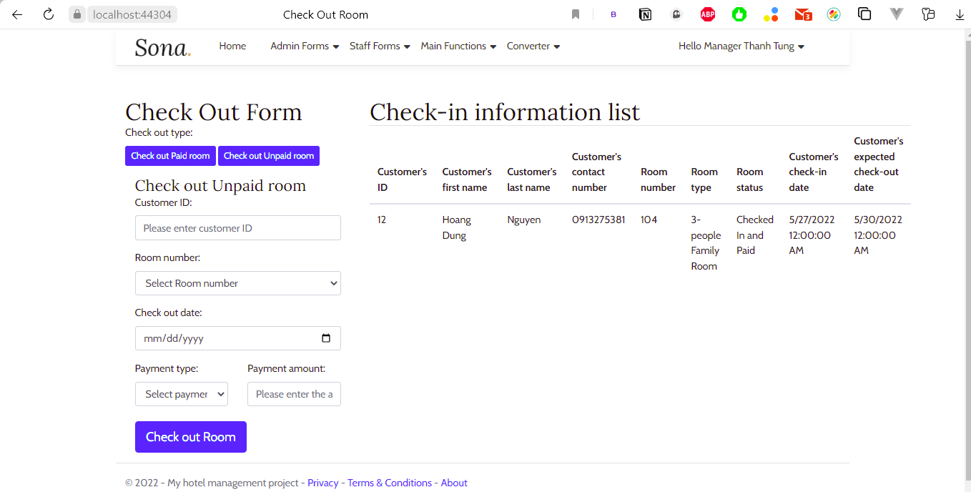

Project structure
Mockup
Project user interface
VMO Holdings
Notes:
Add more page

Slide 9
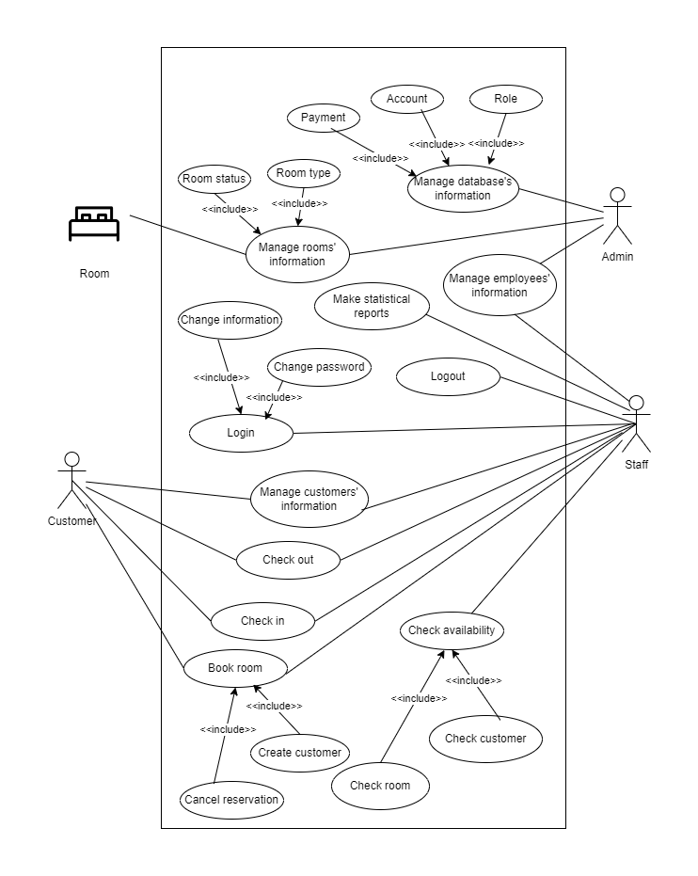

Project structure
Diagram
Use case diagram
VMO Holdings

Slide 10
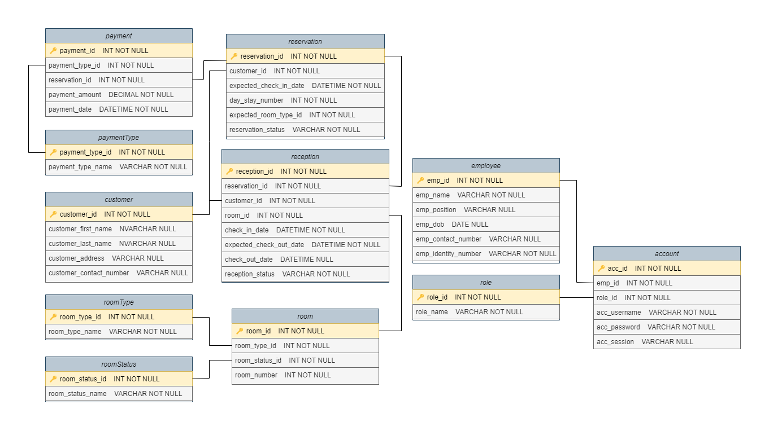

Project structure
Diagram
Class diagram
VMO Holdings

Slide 11


Thank you all for listening!
VMO Holdings

Slide 12
Product demo
VMO Holdings

